Slide 1
Turnitin Update 2021 Changes for staff

Slide 2
Turnitin Update 2021 Overview for staff
Turnitin assignments are created from the Build Content menu.
A more intuitive assignment submission setup interface.
Max Grade setting – previously labelled Point Value.
Feedback Release Date setting – previously labelled Post Date,
Edit the assignment link to update: Title, Instructions, Max Grade & Due Date.
Edit all other settings by: Click on the assignment link > click on the cog in the top right corner.
Access submitted assignments by clicking on the assignment link.

Slide 3
Turnitin Update 2021 Overview for staff cont.
Filter the assignments displayed in the Assignment Inbox by Blackboard groups.
Similarity reports have been enhanced to identify the use of substituted synonyms.
The roster sync has been automated.
Email non-submitters functionality is no longer available – as an alternative use the Send Reminder function in Grade Centre.
Multiple File Upload functionality is no longer available.
A Marking report is now available.

Slide 4
Turnitin Update 2021 Student submission
A more intuitive assignment submission interface.
Submission receipts are no longer sent by email.
Students may download a Digital Receipt from the Assignment Inbox.

Slide 5
Create Turnitin assignments from the Build Content menu

Slide 6
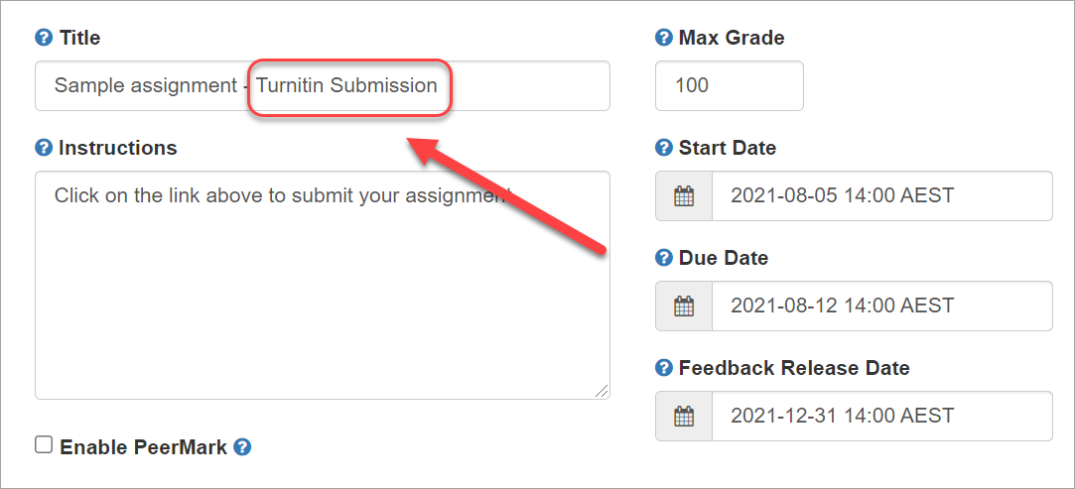
Updated interface
Add “Turnitin Submission” to the title.
Notes:
Turnitin assignment links will no longer be displayed in Blackboard with a Turnitin icon. It is recommended that the words “Turnitin Submission” are added to the assignment title to clearly identify the link to students.

Slide 7
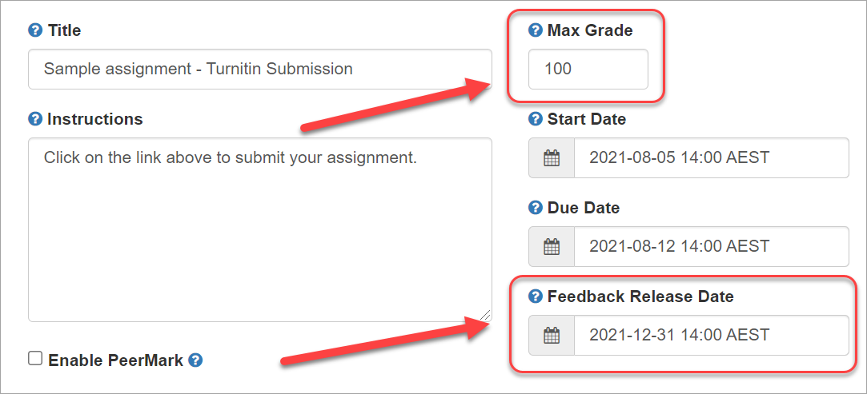
24-hour time
Updated interface
Max Grade – previously Point Value
Feedback Release Date – previously Post Date

Slide 8
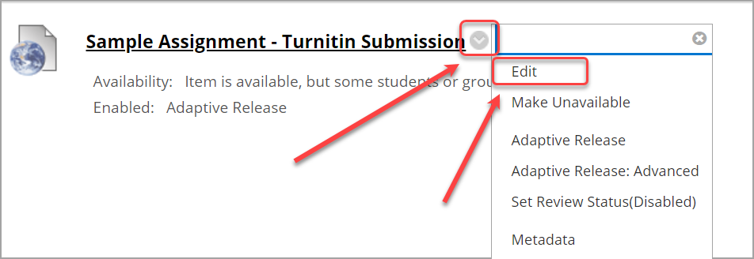
Edit: Title, Instructions, Points (Max Grade) & Due Date
Click on the Down arrow > select Edit

Slide 9
Edit: Other settings
1. Click on the link,
2. Click on the cog.

Slide 10
Access submitted assignments
1. Click on the link,
2. View Assignment Inbox

Slide 11
Filter assignments by Blackboard group
Groups must be set as “Available” in Blackboard.
2.
There may be a delay in new groups transferring to Turnitin.
Notes:
Allocate groups and groups created in Blackboard are available in Turnitin for filtering assignments.
All groups must be set as “Available” in Blackboard to work Turnitin.
There is a delay in new groups created in Blackboard being available in Turnitin. (may take over an hour)

Slide 12
Online Grading Report
Overview of comments per student.
Notes:
Quickmarks (comments) report:
Number of comments per quickmark set (comment bank)
Number of comments per quickmark (comment) for a specific quickmarks set (comment bank)
Results can be downloaded to a CVS file.

Slide 13
Online Grading Report
Overview of rubric criteria results per student.
Notes:
View rubric results for each criteria for each student:
By performance title i.e. Excellent, Good, Poor
By results
Results can be downloaded to a CVS file.

Slide 14
Student view:
Students may download a Digital Receipt from the Assignment Inbox.
Note: Submission receipts are no longer sent by email.

Slide 15
Student view:
Students may resubmit using the Resubmit paper button.
Note: Students will receive a message on how many Similarity Reports they have remaining.
Notes:
Student can receive up to 3 similarity reports they then need wait 24 hours for each additional report.

Slide 16
Thank you
eLearning Systems and Support
Institute of Teaching and Learning Innovation
help@elearning.uq.edu.au
www.elearning.uq.edu.au

