Slide 1
Turnitin Update 2021 Changes for students

Slide 2
Turnitin Update 2021 Student submission
A more intuitive assignment submission interface.
Submission receipts are no longer sent by email.
Students may download a Digital Receipt from the Assignment Dashboard.

Slide 3
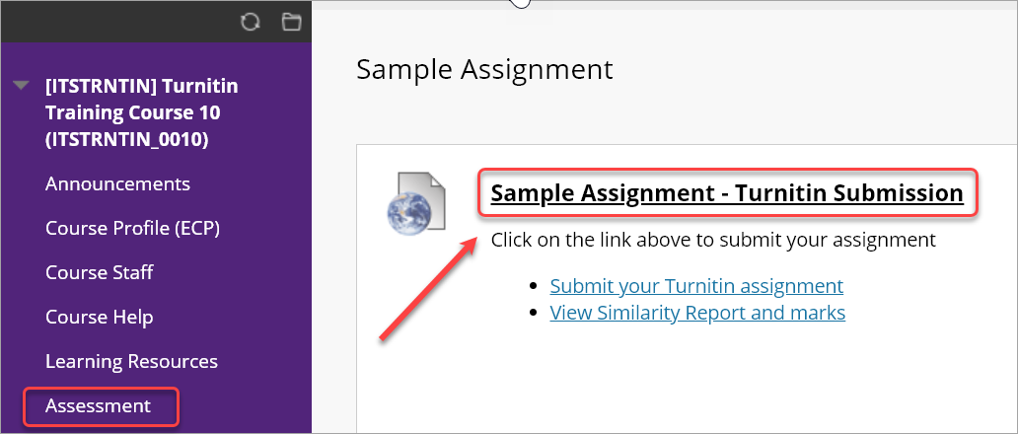
Updated submission process
Step 1: Click on the assessment submission link
Notes:
Note, the submission link no longer displays the Turnitin icon.

Slide 4
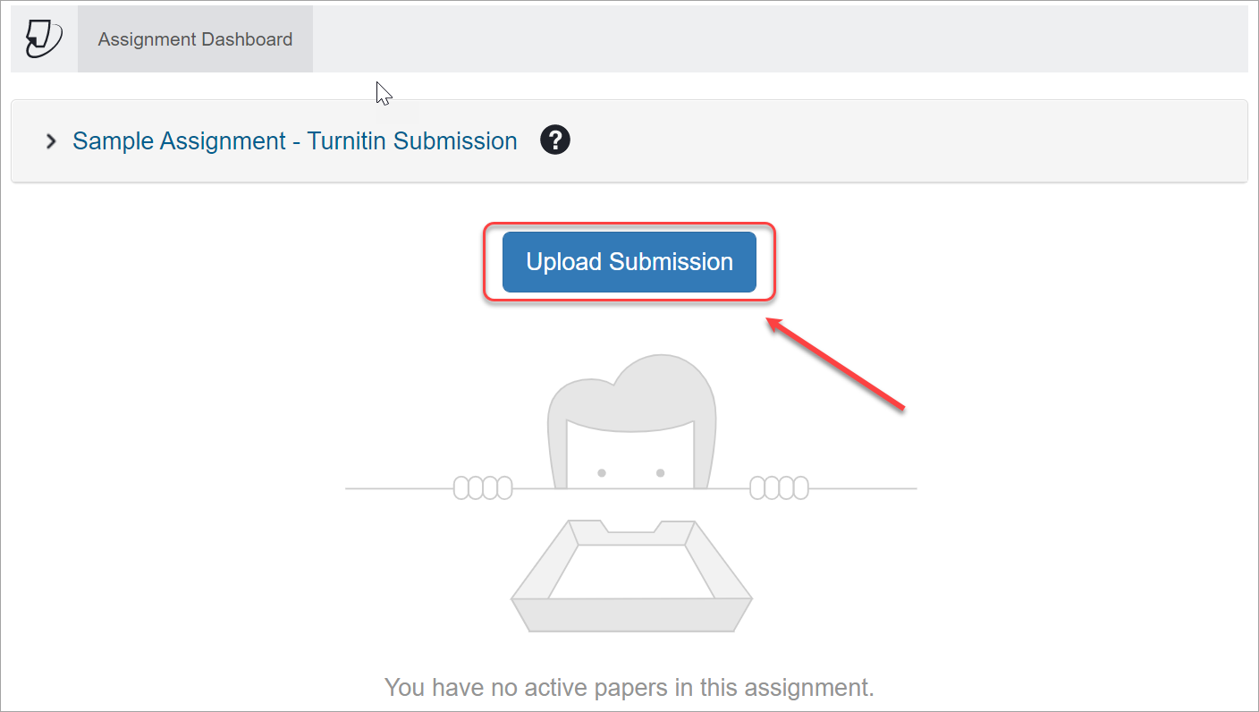
Updated submission process
Step 2: Click on the Upload Submission button.

Slide 5
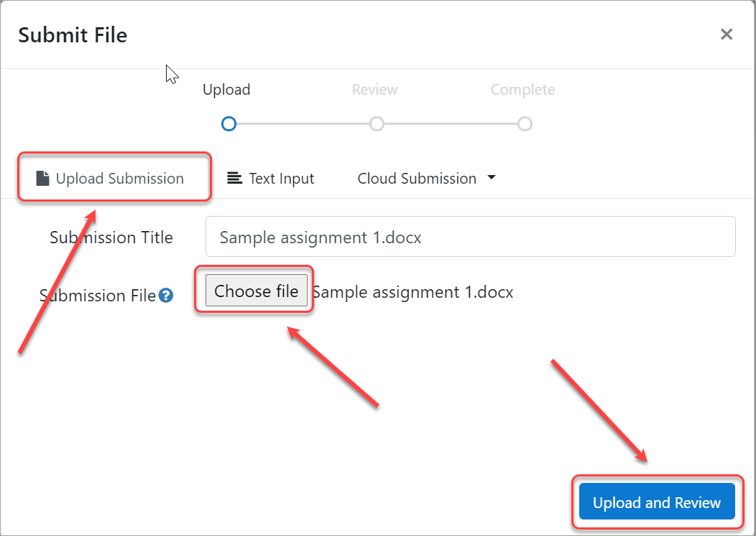
Updated submission process
Step 3: Choose file > select the file > Upload or Review.
Notes:
Note, there are also Text Input and Cloud Submission (Google Drive, OneDrive, DropBox) options.

Slide 6
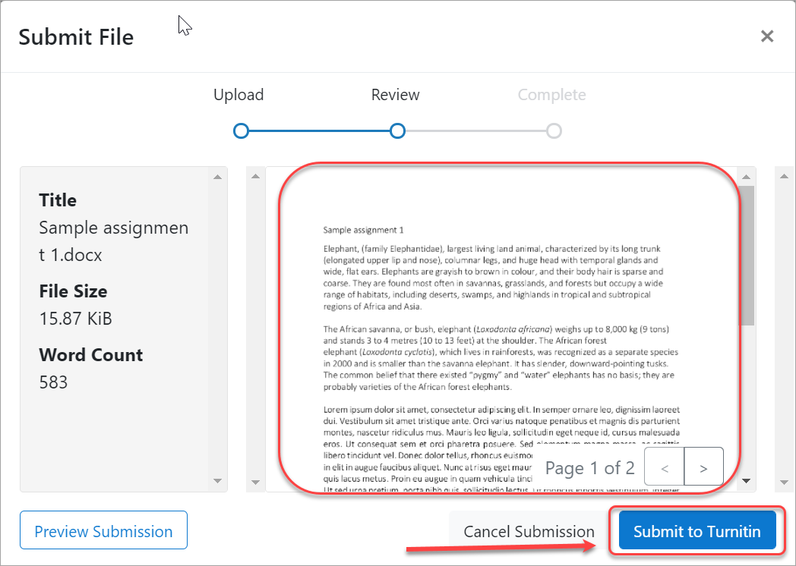
Updated submission process
Step 4: Check the submission > Submit to Turnitin
Notes:
Note, there are also Text Input and Cloud Submission (Google Drive, OneDrive, DropBox) options.

Slide 7
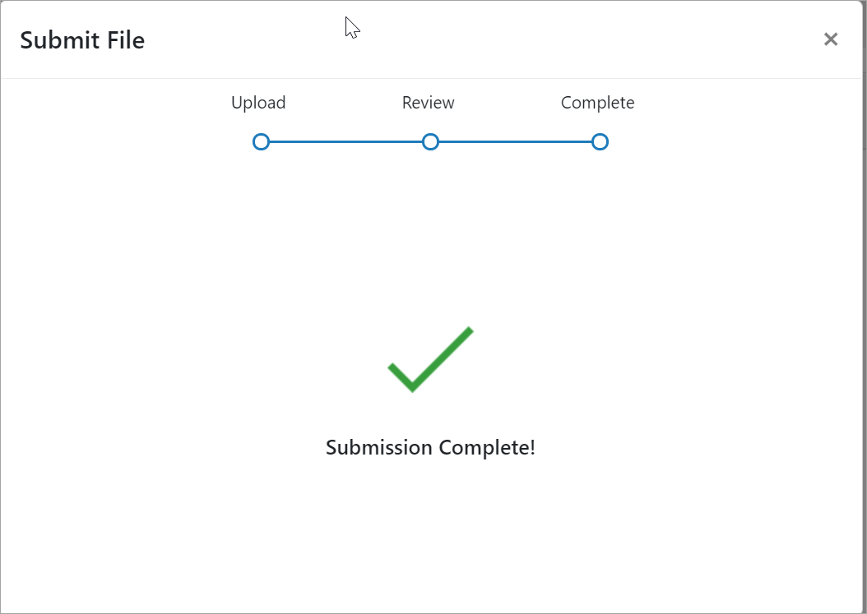
Updated submission process
Step 5: Submission Complete! message displayed

Slide 8
Updated submission process
Step 6: Download the Digital Receipt
Note: Submission receipts are no longer sent by email.

Slide 9
Updated re-submission process
If needed, click the Resubmit paper button.
Note: You will receive a message on how many Similarity Reports you have remaining.
Notes:
Student can receive up to 3 similarity reports they then need wait 24 hours for each additional report.

Slide 10
Thank you
eLearning Systems and Support
Institute of Teaching and Learning Innovatoion
khelp@elearning.uq.edu.au
www.elearning.uq.edu.au

